Slide 1
Phantom Limb Syndrome
Mojtaba Kanani

Slide 2
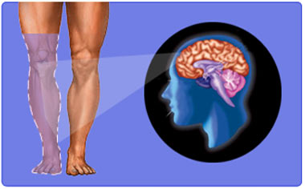
Phantom Limb
A phantom limb is the sensation that an amputated or missing limb is still attached.

Slide 3
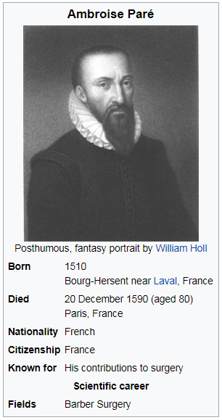
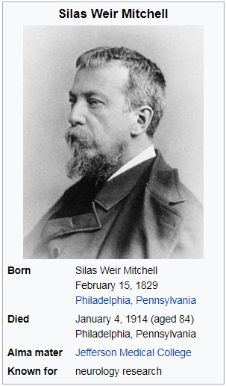
History
1872
1551

Slide 4

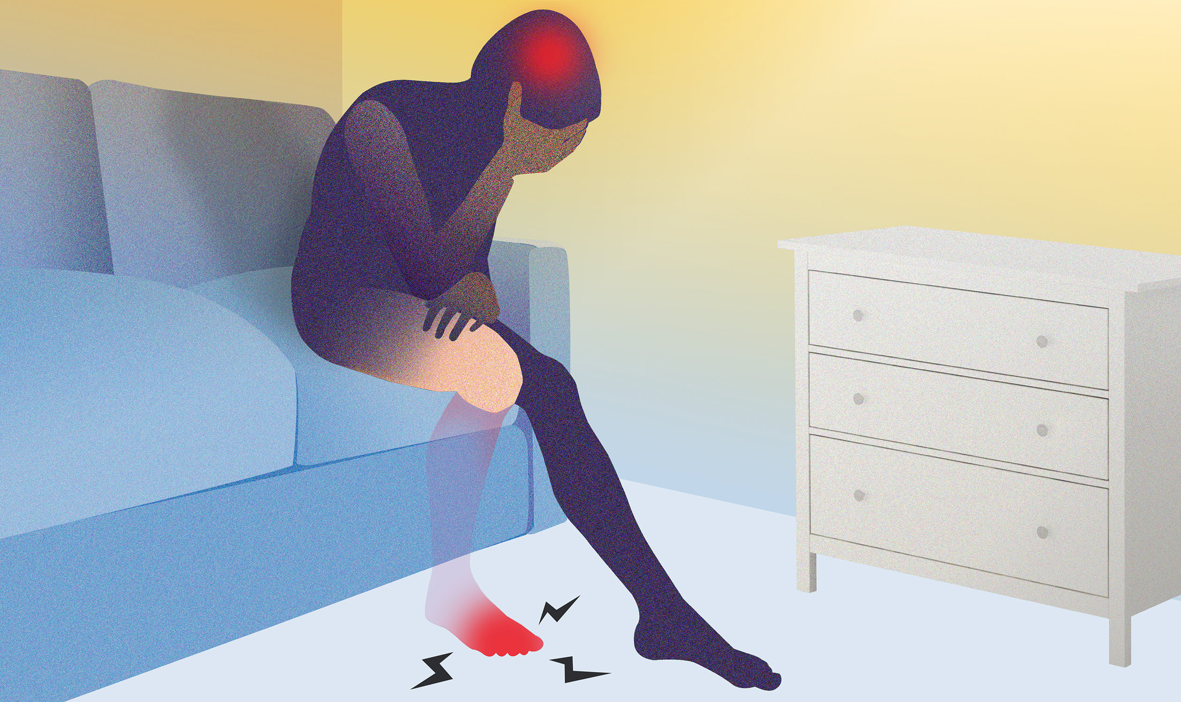
Reason

Slide 5
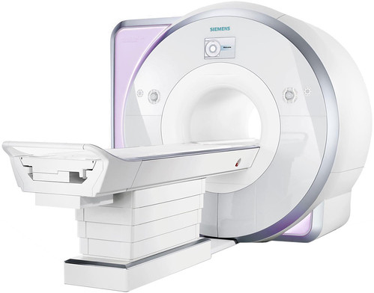
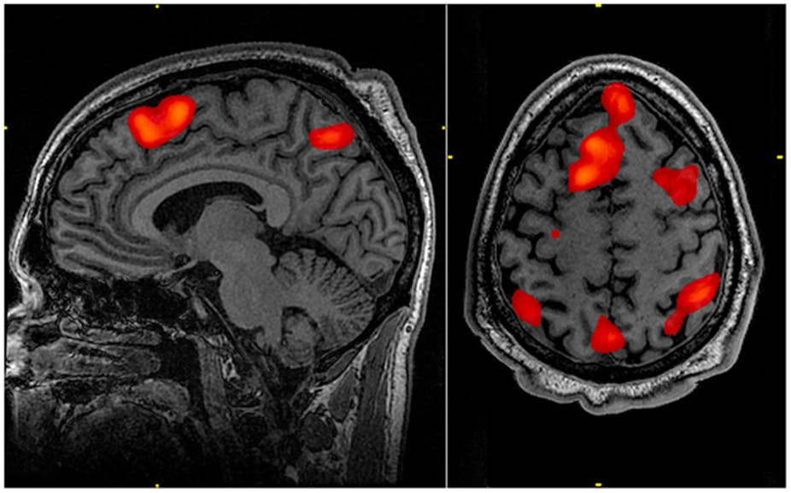
FMRI
Functional magnetic resonance imaging
1990

Slide 6
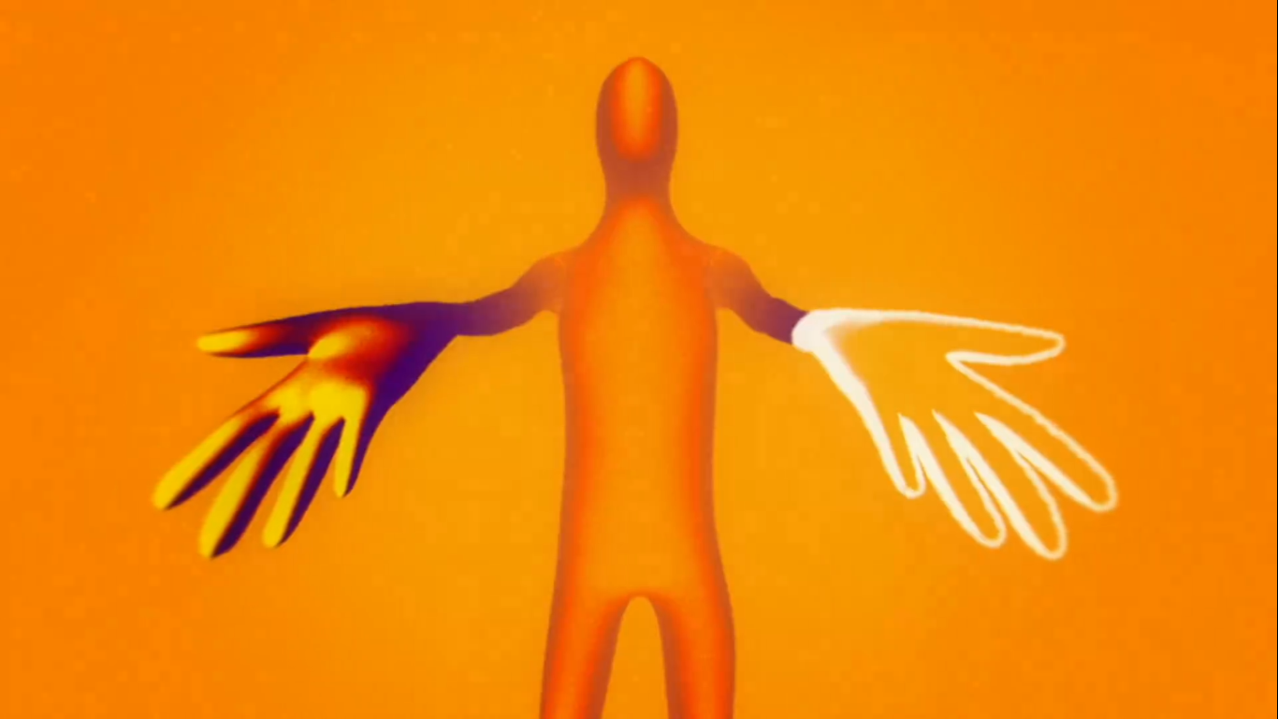
Phantom Limb Syndrome
Phantom limb syndrome is a condition in which patients experience sensations in a limb that does not exist.
80% - 100%

Slide 7
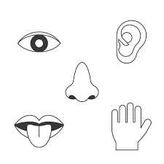
Not just in Limbs
Nose
Internal Organs
Eye
…

Slide 8
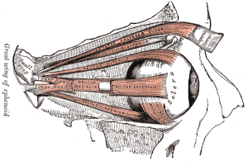
Phantom Eye Syndrome
Pain – 26%
Charles Bonnet Syndrome (Visual hallucinations) – 30%

Slide 9
Phantom Sensation Types
Kinetic
Kinesthetic
Exteroceptive

Slide 10
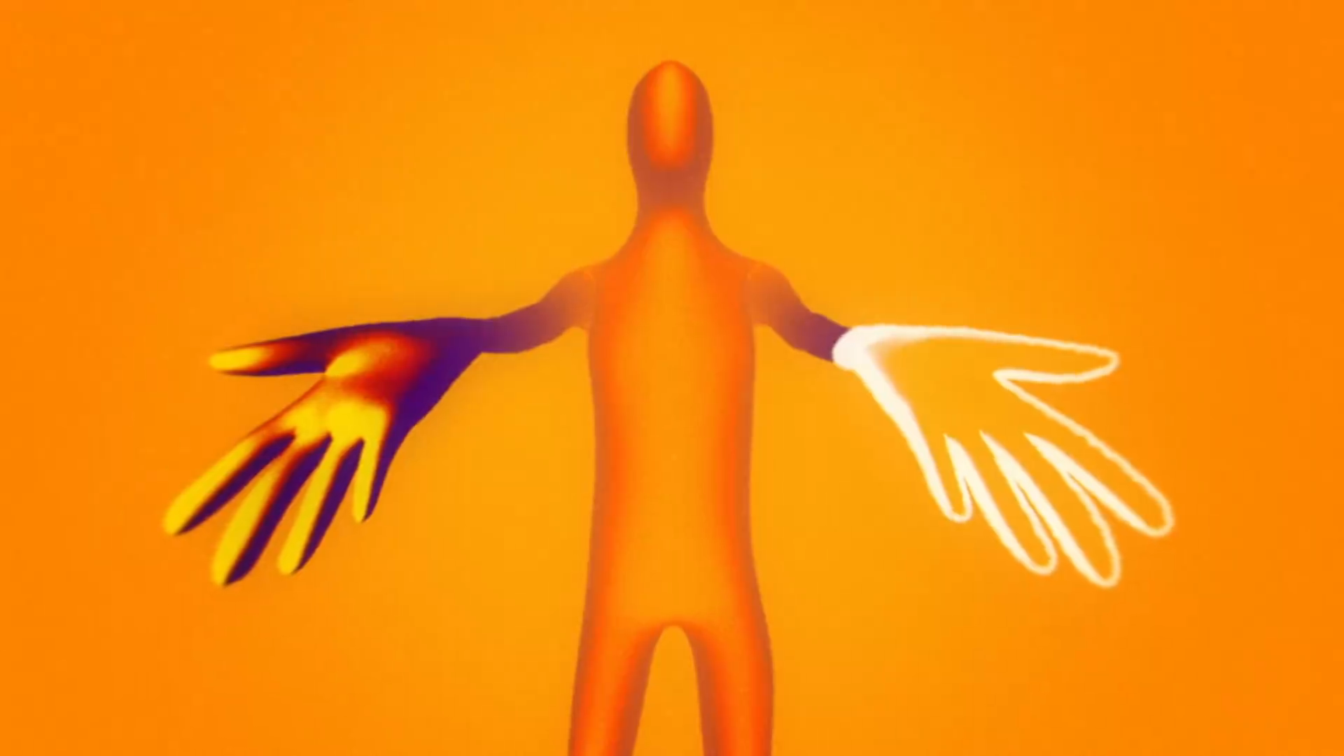
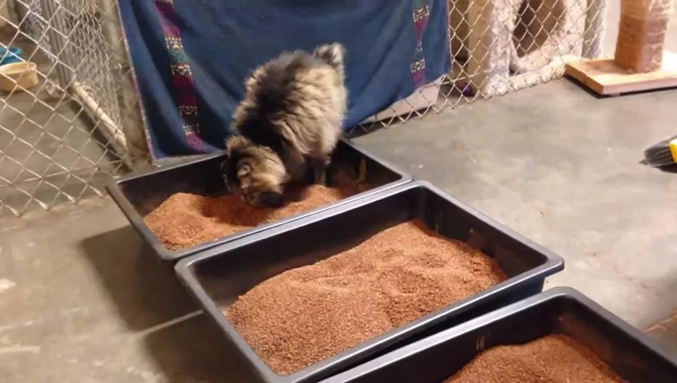
Kinetic
Sensations Related to Movement of Phantom Limb
Voluntarily / Involuntary

Slide 11
Kinesthetic
Sensations related to Size , Shape , Position of Phantom Limb.
Bigger / Smaller / Same as real / Changing
Unhurt / Injured
Relax / Painful

Slide 12
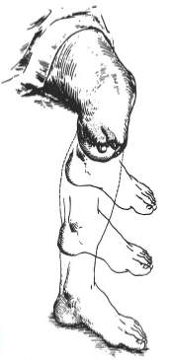
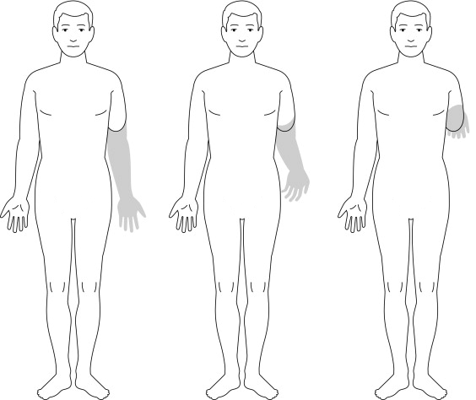
Telescoping

Slide 13
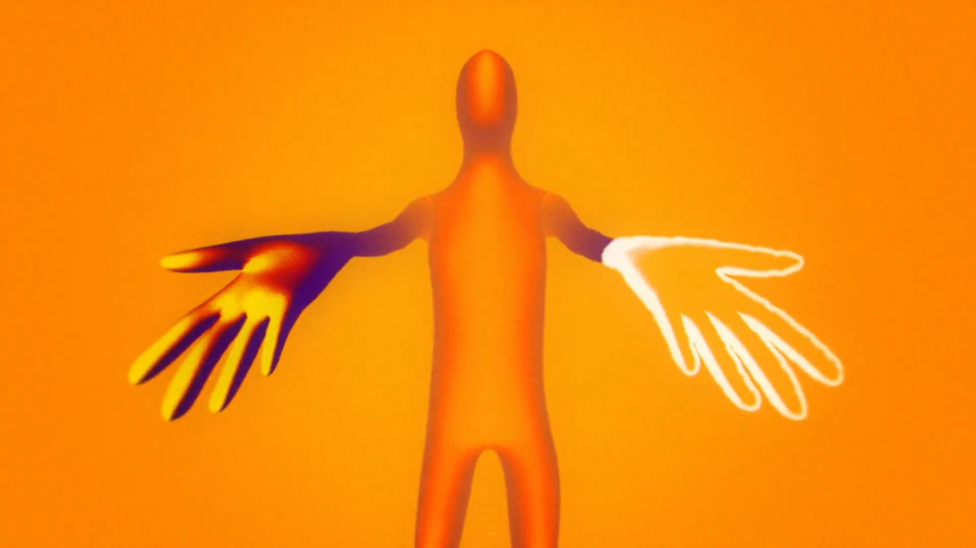
Exteroceptive
Sensations related to Touch , Pressure , Temperature , Itch of Phantom Limb.
Also Feelings Related to External Objects being applied to Phantom Limb
Wedding Ring , Watchband , Tight Shoelaces

Slide 14
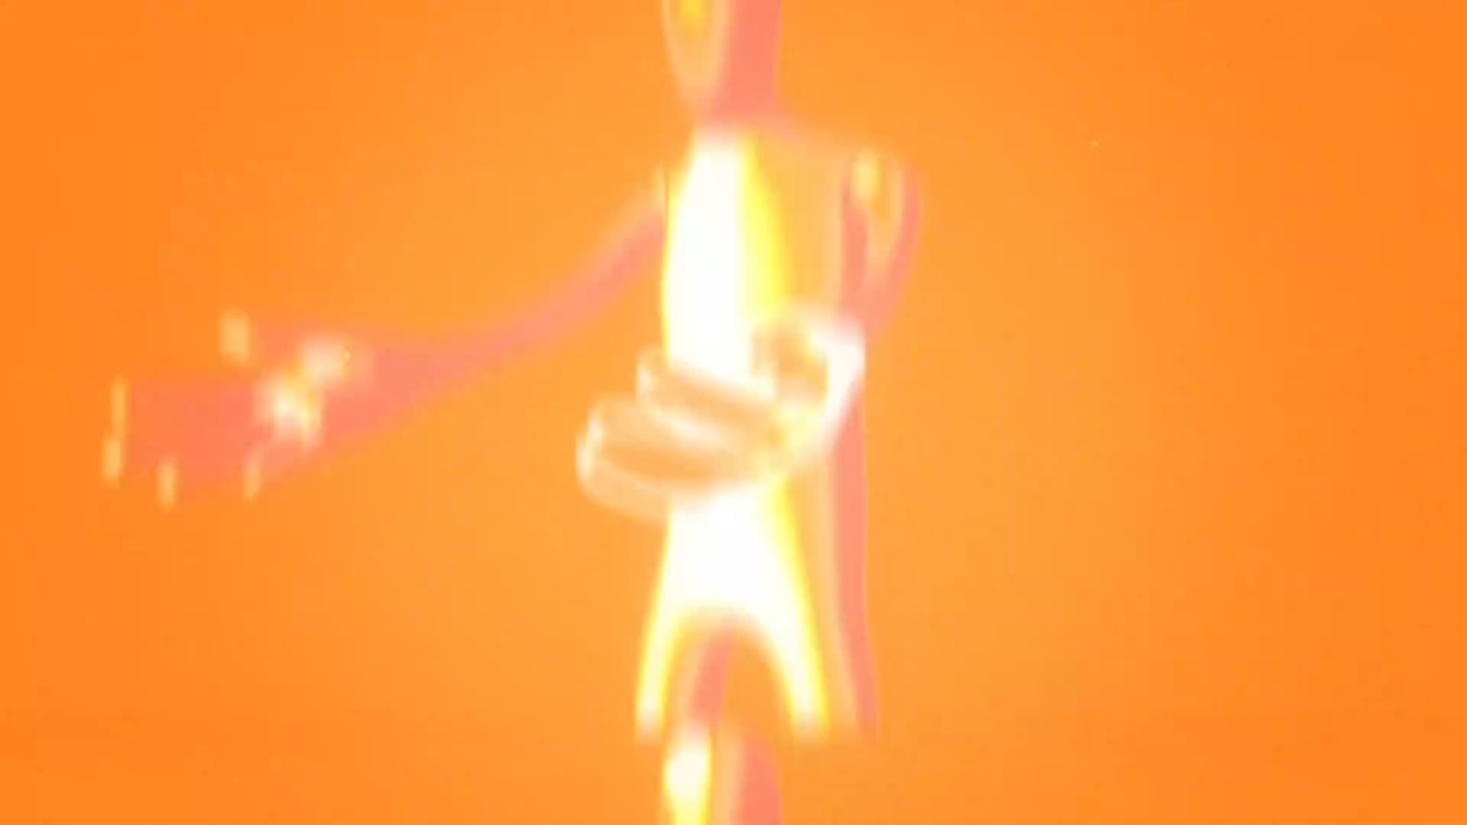
Phantom Limb Pain
60% - 80% feel Phantom Limb Pain
75% Early – 25% Late
Sometimes Start even Years after amputation
Duration

Slide 15
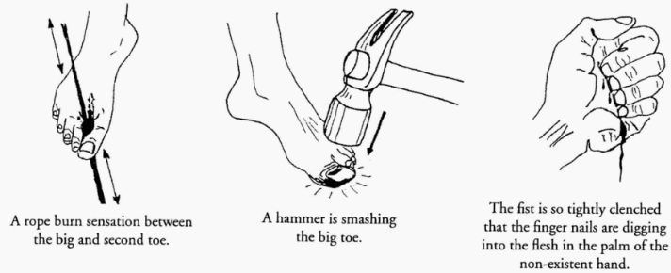
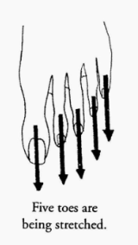
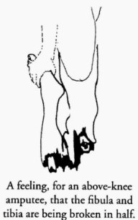
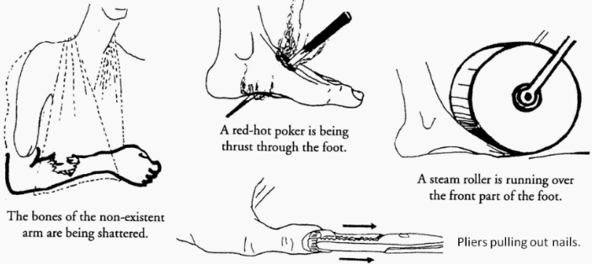
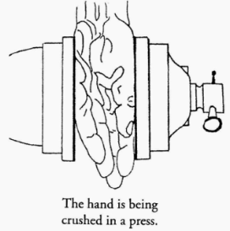
Common Types of Phantom Limb Pain

Slide 16
Difference
Phantom Limb Syndrome
Phantom Pain
Stump Pain – 50%

Slide 17
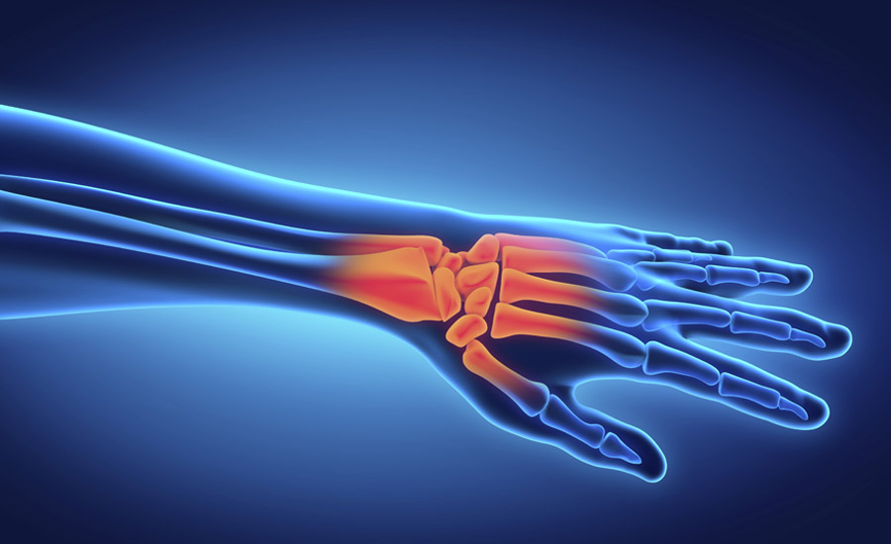

Why Pain?
Pain and Injury

Slide 18
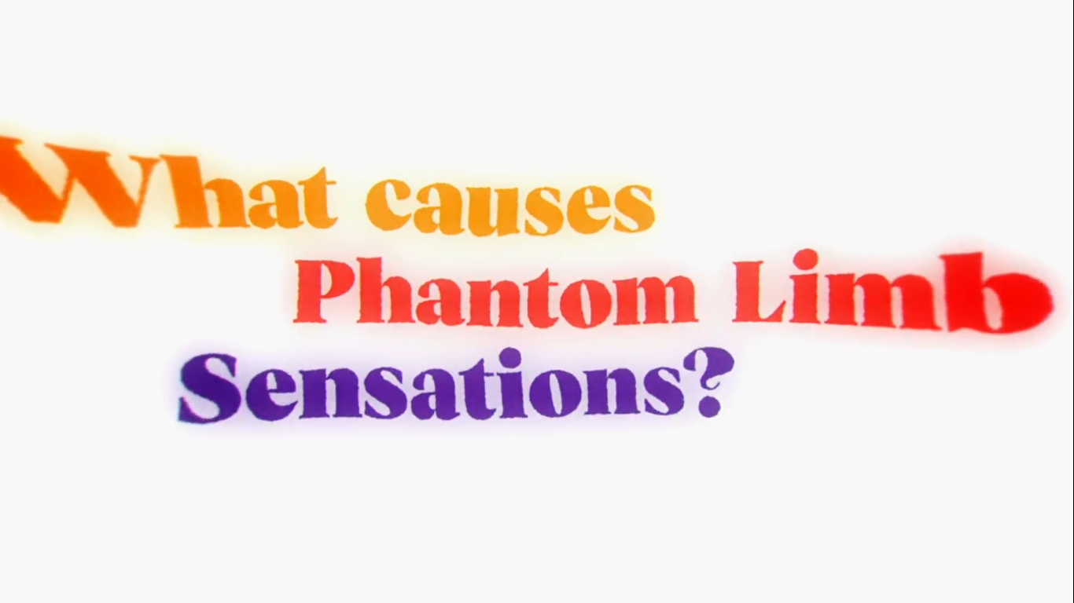

Slide 19
Theories
Peripheral mechanisms
Central mechanisms
The Neuromatrix
Psychological Theory
…

Slide 20
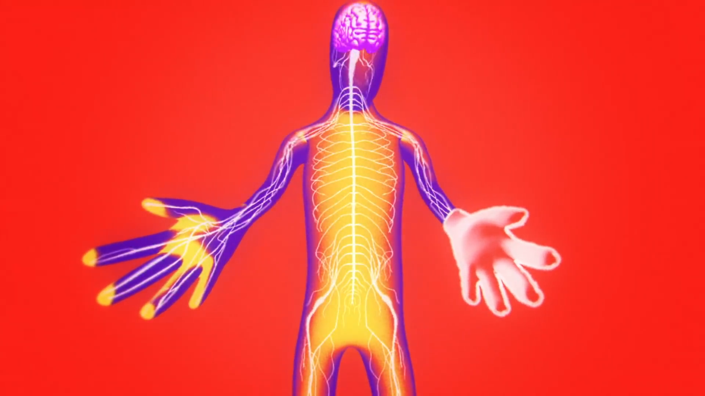
Peripheral mechanisms

Slide 21
Problems
Even removing neuromas doesn’t cure phantom pain.
Cant explain phantom pain in people with congenital limb deficiency.

Slide 22
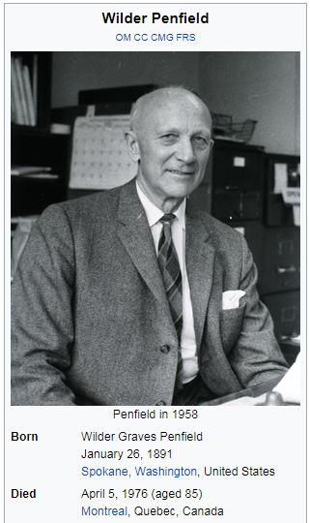
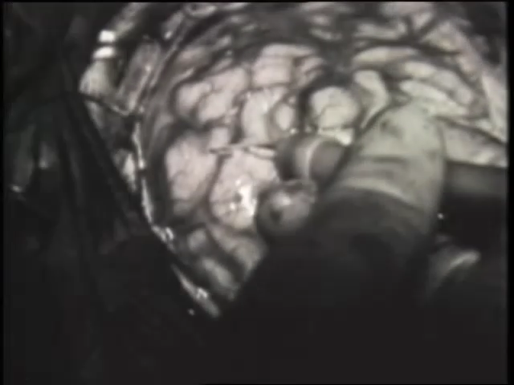
Central mechanisms
Brain Mapping

Slide 23

Cortical Homunculus

Slide 24
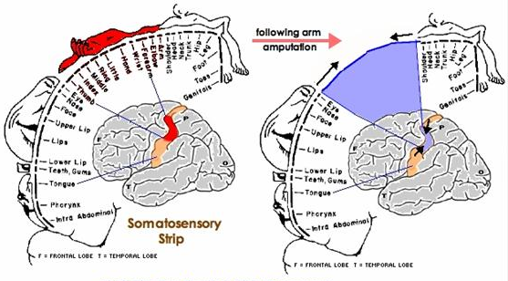
Brain Remapping

Slide 25
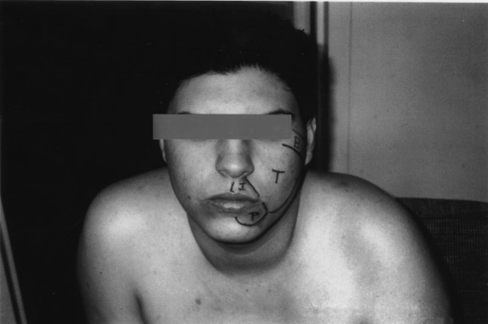
Brain Remapping

Slide 26
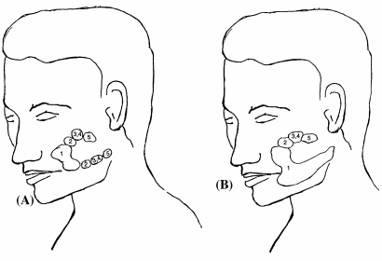
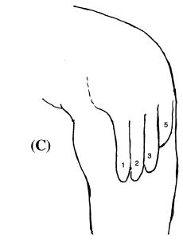
Brain Remapping

Slide 27
Problem
Not everyone feel phantom limb and phantom pain.

Slide 28
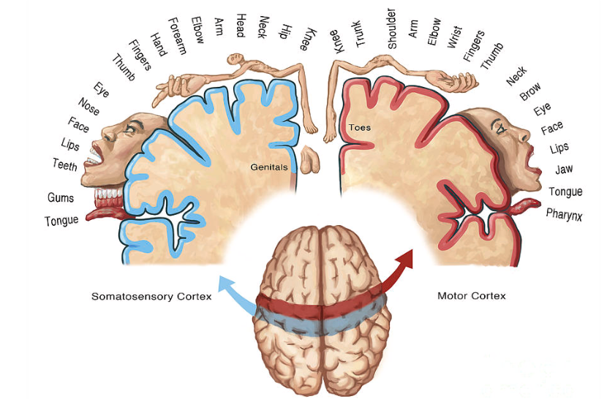
Phantom Limb and Age
Age < 2 20%
2 < Age < 4 25%
4 < Age < 6 61%
6 < Age < 8 75%
Age > 8 100%

Slide 29
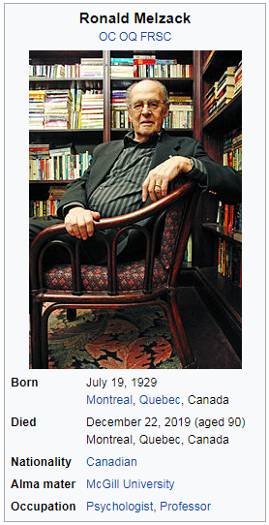
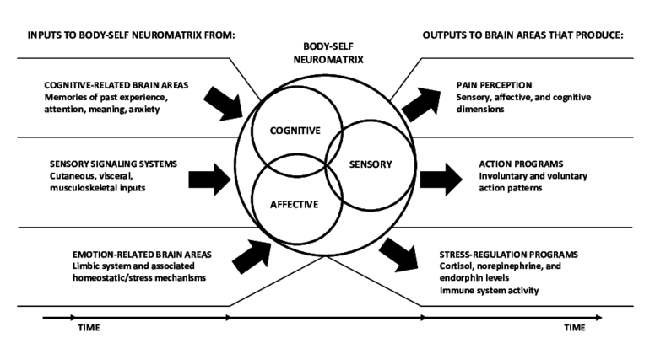
The Neuromatrix
Self
NeuroSignature

Slide 30
Problems
does not address how sensations can spontaneously end.
Not everyone feel phantom limb and phantom pain.
can not be tested empirically.

Slide 31
Psychological Theory
wish fulfillment
denial of the loss of a part
"Just as the widow finds it hard to believe that her husband is dead and often has a strong sense of his presence, so the amputee has difficulty in accepting the loss of his limb and he continues to feel it is present "

Slide 32
Problems
FMRI shows that the pain is really there.

Slide 33
Why Pain?
Our Brain is not just Reporting Everything

Slide 34
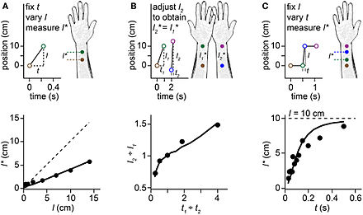
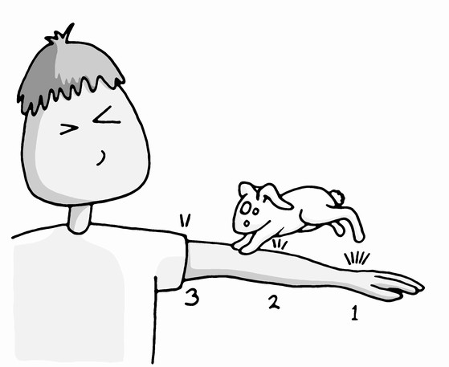
Cutaneous Rabbit Illusion

Slide 35
What is the Truth?
Is it illusion?
Is pain illusion?

Slide 36
Risk Factors
Upper Limb or Lower Limb
Traumatic limb loss or Surgical amputation
Preamputation History
Stump Condition
Mechanical or electrical Stimulation
Stress
…

Slide 37

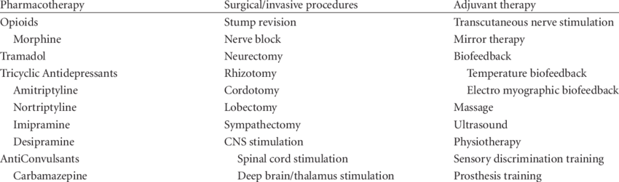
Treatment

Slide 38
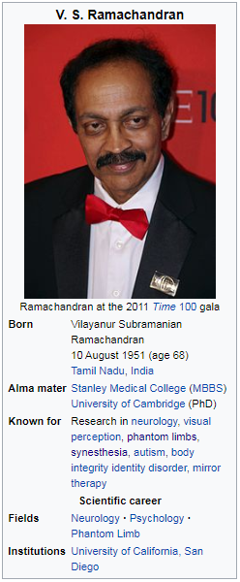
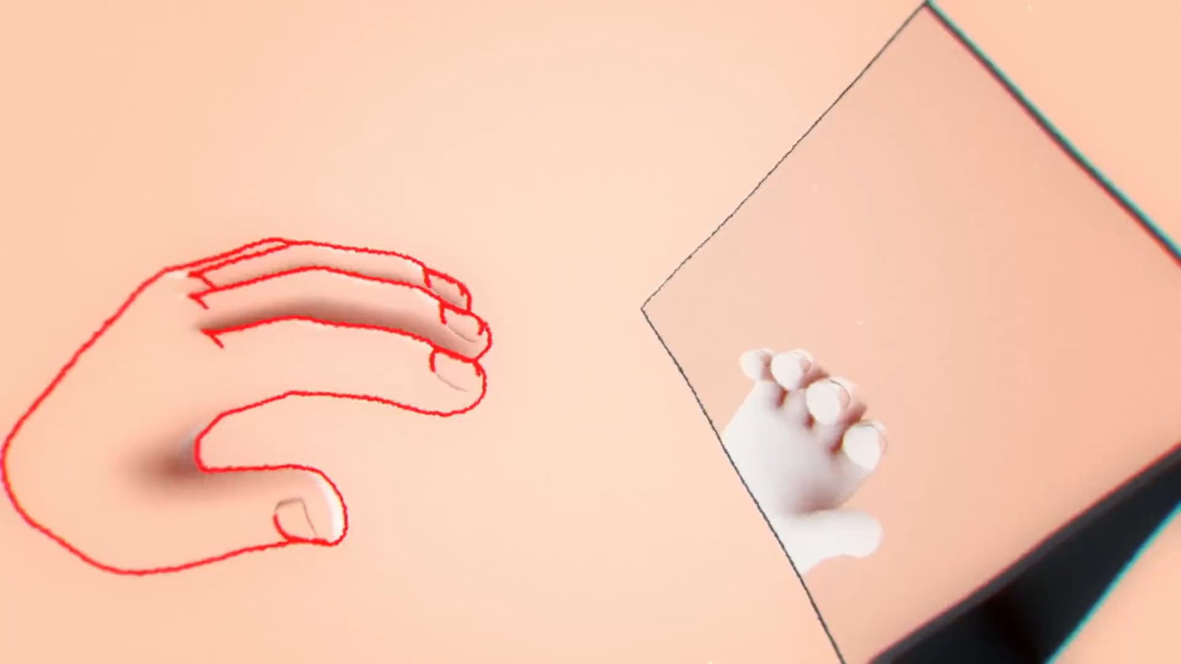
Mirror Box Therapy

Slide 39
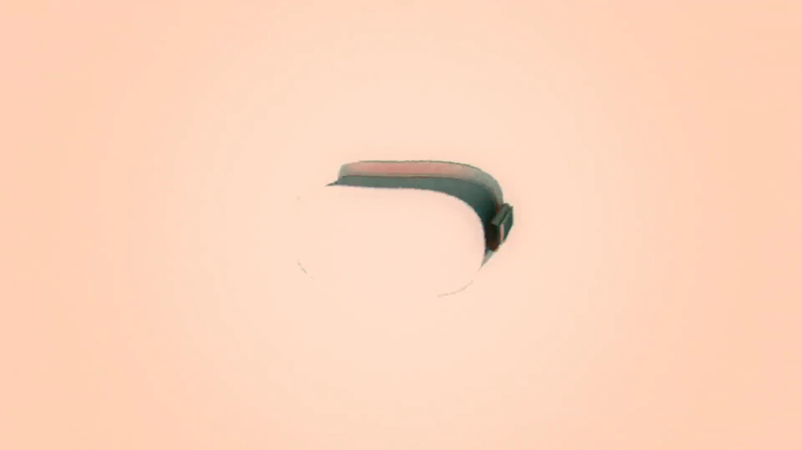
Virtual Reality

Slide 40

Prosthetics

Slide 41

Questions

Slide 42
Thanks for your attention

